Slide 1

space Club

Slide 2

About Our Club
Who We Are: A passionate group of students dedicated to exploring and learning about astronomy.
Mission: To engage students in the wonders of space through observation, education, and discussion.

Slide 3
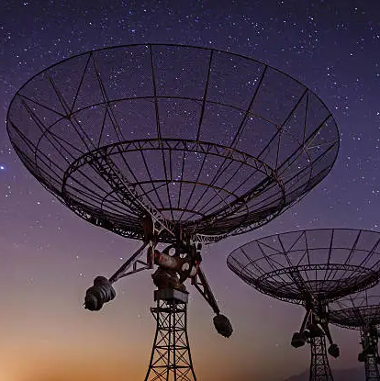
Club Activities
Observing Nights: Regular stargazing events where members use telescopes to observe celestial objects.
Workshops: Hands-on sessions about telescopes, astrophotography, or astronomical software.
Guest Lectures: Talks from professors, astronomers, or special guests.
Field Trips: Visits to local observatories or planetariums.

Slide 4
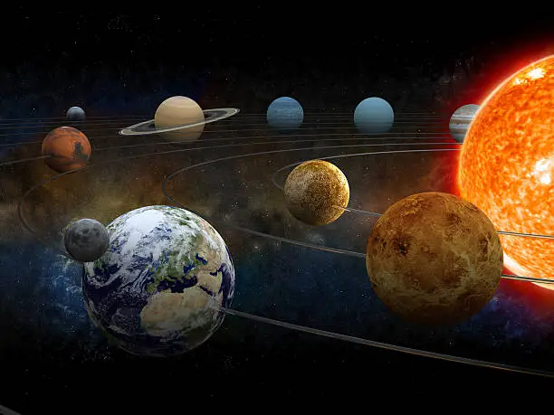
Workshops and Learning
Telescope Basics: How to set up and use a telescope.
Astrophotography: Techniques for photographing celestial objects.
Astronomy Software: Introduction to software like Stellarium or Starry Night for sky mapping.
Deep Space and Solar Observation: Special sessions focusing on different types of observation.
Observation Nights: Organize telescope viewing sessions to observe celestial bodies like planets, the Moon, and star clusters.

Slide 5
Activities for the Astronomy Club
Guest Lectures: Invite professors, astronomers, or even astronauts to talk about various topics.
Planetarium Visits or Virtual Tours: Organize field trips or virtual sessions exploring planetariums or space simulations.
Rocket Building or Space Projects: Conduct workshops on model rocketry or astrophysics-related experiments.
Space News & Discussion Groups: Have sessions where members discuss recent astronomical discoveries or missions.

Slide 6
Club Growth and Engagement
Collaborations: Work with other science clubs or departments for interdisciplinary events.
Social Media Presence: Share club activities on platforms like Instagram, Twitter, and Facebook to attract new members.
Themed Nights: Hold special events around space-related anniversaries or phenomena (e.g., eclipses, meteor showers).
Competitions or Quizzes: Organize fun trivia, debates, or project presentations to keep members engaged.

Slide 7

Tools and Resource
Telescopes: Invest in club-owned telescopes or collaborate with your college for access.
Software: Utilize star-mapping apps like Stellarium or SkySafari during observation sessions.
Space-Related Magazines or Websites: Subscribe to resources like NASA, Space.com, or Astronomy Magazine to stay updated.

Slide 8
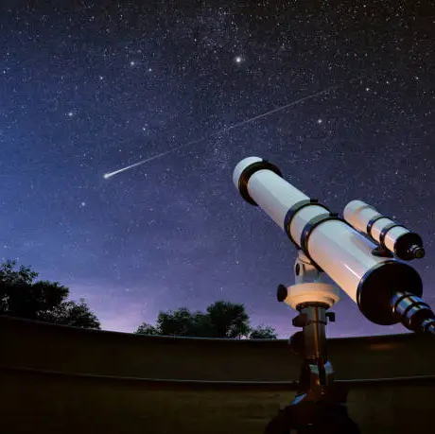
Thank everyone for their interest in the Space Club
Reiterate how to stay connected via social media or email.
Encourage everyone to look up and keep exploring the universe.

Slide 9
Thank you

